Slide 1
Presentation 6:
CNN Team
Hannah Ma, Margaret Pirozzolo,
Nathan Jung, Sari Eisen, Sharon Lin

Slide 2
01
DenseNet

Slide 3
DenseNet Architecture
Densely Connected Convolutional Network
Addresses vanishing gradient problem
Direct connections between all layers in a block
Each layer receives full feature maps from all previous layers as inputs
Encourages feature reuse, reducing redundancy and increasing efficiency
Fewer features to learn
N layers → N(N+1)/2 direct connections
Notes:
Sari

Slide 4
DenseNet Architecture
Densely Connected Convolutional Network
Transition layer connects dense layers
Batch normalization
Convolutional layer
Average pooling
Reduces overfitting
High memory usage and computational complexity
Notes:
Sari

Slide 5
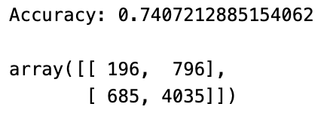
DenseNet
Trained 31 epochs in 20 hours
Did not reach stopping point but did not have enough computing power to finish training
74% accuracy on test data
Not very good at classifying benign cases
Notes:
Margaret

Slide 6
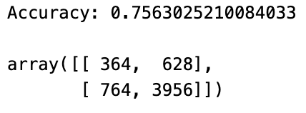
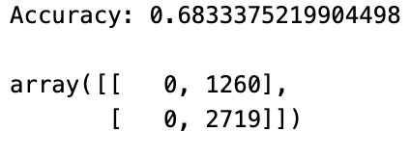
DenseNet
Trained 7 epochs in 2 hours
Fewer epochs but retrained every parameter every time, no freezing of params (like in the previous example)
~76% accuracy on test data
Tried this same method with more epochs and early stopping, but that failed miserably, and still stopped at 5 epochs
Does not classify benign
Notes:
Margaret

Slide 7
DenseNet
Next Steps
Retraining every parameter without freezing offers better results in fewer epochs
The epochs take more time to compute
Recommend the second method, and using more computing power to train more epochs and tune hyperparameters
DenseNet seems like out best performing model on the whole dataset, so would recommend sticking with this one next quarter
Notes:
Margaret

Slide 8
02
AlexNet

Slide 9
AlexNet Architecture
First to incorporate training on GPUs
Simpler architecture, faster model
5 convolutional layers, 3 fully connected layers
Usually includes max pooling
Overall structure:
(CNN → RN → MP)² → (CNN³ → MP) → (FC → DO)² → Linear → softmax
Momentum gradient descent
Notes:
Sari
Convolutional, normalization, max pooling, fully connected (w/ RELU), linear (w/o RELU), dropout

Slide 10

AlexNet
Statistics are from “CNN model .001-morelayers-less patience”
Trained 9 models over the course of this week, with varying times to train
Highest test accuracy of all the models was 65.7% with model: “CNN model .001-morelayers-less patience”
Patches were separated according to case number and randomly split.
Accuracy is on a patch level
Multiple different iterations were tried
Different learning rates
Using only h&e samples
More and less patience
Evenly splitting between benign and high grade cases
Allowing more and less layers to be modified while training
Notes:
Nathan

Slide 11
AlexNet
Notes for the future
Allowing more layers/parameters to be trained seems to be the way to go
I stopped a model early that allowed all the parameters to be trained, but it showed promise. Using a validation set to determine the backpropagation step or using clever techniques to prevent overfitting might allow us to reach higher accuracies than with only transfer learning.
The sweet spot learning rate for AlexNet appears to be .001
More data will likely be necessary for Alexnet. The model requires large amounts of variation and samples to draw from to prevent overfitting, more-so than other models.
If this model is going to be used in the future, data augmentation will be necessary, perhaps for other models as well.
Google Colab credits are necessary for CNN model training
I do not recommend future use of AlexNet
Notes:
Alexnet was one of the first cnn models to come out, which is likely why its accuracy is not that high.
Nathan

Slide 12
03
ResNet
Notes:
Sharon

Slide 13

ResNet Architecture
Residual Network
Skip connections: connects activations of a layer to further layers, skipping in-between
Stack these “residual blocks”
Addresses vanishing/exploding gradient problem
Let the network fit the residuals instead of the the underlying mapping
Notes:
Sari - unless someone else wants to

Slide 14
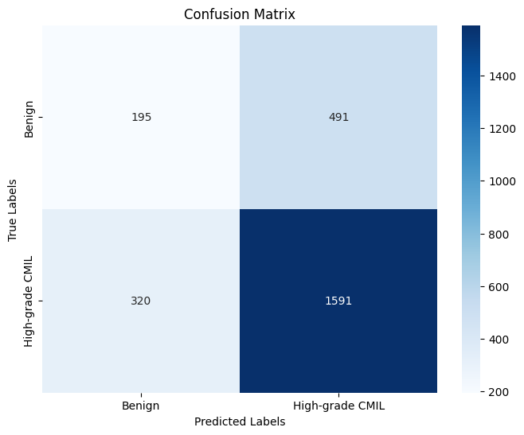
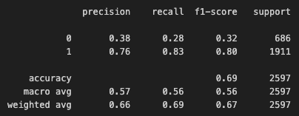
ResNet Results
Trained ResNet50 model on all patches available on Google Drive folder using Colab GPUs
patient-level train/validation/test split
only 5 epochs of training due to limited computing power
Achieved 69% patch-level accuracy
Bad at predicting benign cases
likely due to class imbalance
Notes:
Sharon

Slide 15
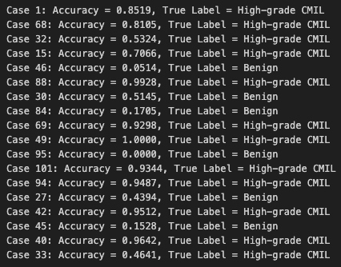
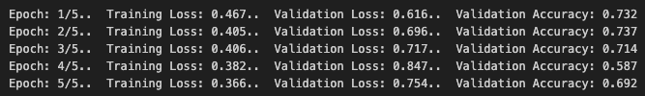
ResNet Results
Notice that training loss was decreasing per epoch but validation loss was increasing per epoch
sign of overfitting (to high grade CMIL cases, additional evidence of class imbalance)
Patient level accuracy is high for high grade CMIL cases, but very low for benign cases
Notes:
Sharon

Slide 16
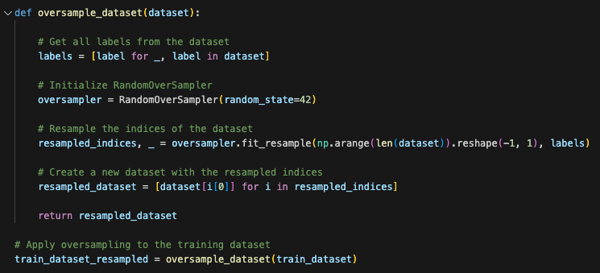
Data Imbalance - Oversampling
Potential solution to data imbalance – oversampling the minority class
Wrote code that randomly oversamples benign patches in the training dataset so there is even split between benign/high-grade CMIL patches
Was not able to test code due to Colab GPU computation limitations
Notes:
Sharon

Slide 17
04
Next Steps

Slide 18
Colab Credits
Google offers several different GPU’s on Colab, accessible via purchasing ‘compute units’:
$9.99 = 100 compute units
Costs are rough as a pricing is dynamic
Processor | Compute units / hr | Time per 100 units | Models trained per 100 units
T4 | 1.84 | 54:20 | 13
L4 | 4.82 | 20:47 | 5
A100 | 10-15 | 8:30 | 2
Notes:
GPU compute unit usage source: https://mccormickml.com/2024/04/23/colab-gpus-features-and-pricing/
hannah

Slide 19
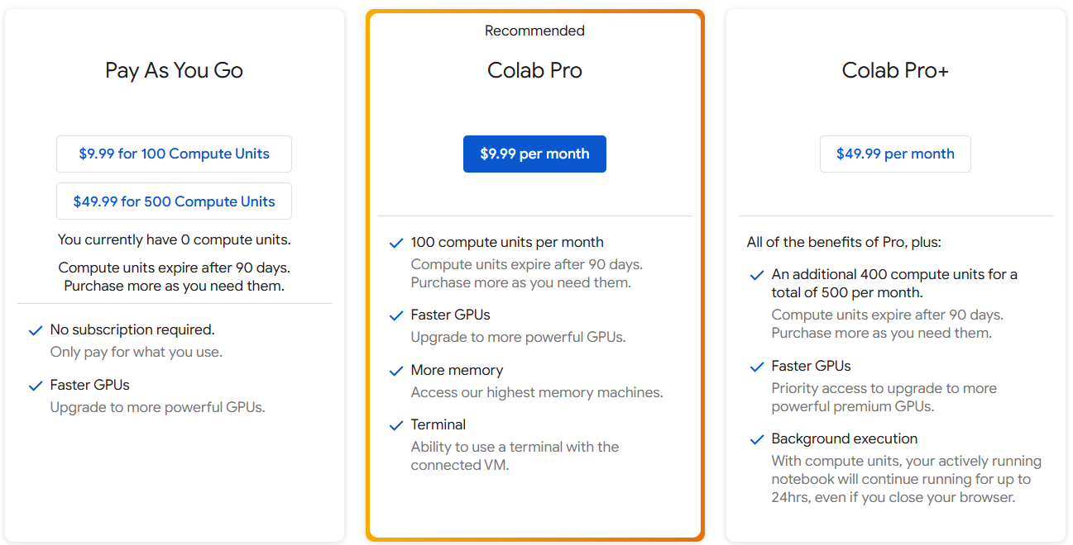
Pay as You Go seems most appropriate, but there is no way to transfer compute units
Only way to share credits or distribute them to a class is to give everyone Colab Pro licenses as an administrator
Notes:
hannah

Slide 20
Free alternative: QUEST
1239 nodes, including 93 GPU nodes (273 GPU cards total) + 25 high-memory nodes
General Access:
541 regular nodes
34 GPU nodes
1 high-memory node
Buy-In
Researchers gain first priority for jobs on buy-in nodes
Notes:
Faculty can request an allocation on QUEST for research or classroom purposes
hannah

Slide 21
Workshop + Classroom Allocation
Designed for projects requiring <100k compute hours = 12 processors running for ~1yr
2TB shared storage, 80GB personal storage/student
Gain access to QUEST Analytics Nodes
3 nodes each w 52 CPU cores and 1500 GB RAM
compatible with Jupyter Notebooks
Other jobs require writing a job submission script via Bash
Jobs expected to take <4hrs gain higher priority
Active for duration of requested quarter, all files and accounts deleted 3 weeks after end of quarter if renewal is not requested
Submit request ≥1 week before class start date
Notes:
hannah

Slide 22
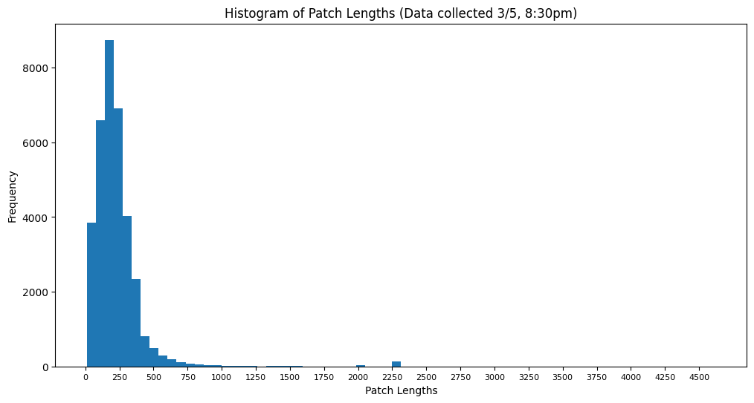
Patch size distribution
Notes:
Sari

Slide 23
Thank you!
Questions?

